Slide 1
Lecture 12
Another loop for repetition
The while loop construct
© 2010 Daniel Valentine. All rights reserved. Published by Elsevier.

Slide 2
Concept of while loops
Recall from a previous lecture, loops are MATLAB constructs that allow a sequence of MATLAB commands to be executed more than once.
A while loop repeats a block of commands as long as an expression controlling it is true (1).

Slide 3
The while loop construct
Construction of a while loop:
  while expression
  command #1
  command #2
  command #3
  …
  end
  The loop ends when “expression” is false (0); at this point the commands following the end of the loop is executed.
code block is repeated while expression is true (1)

Slide 4
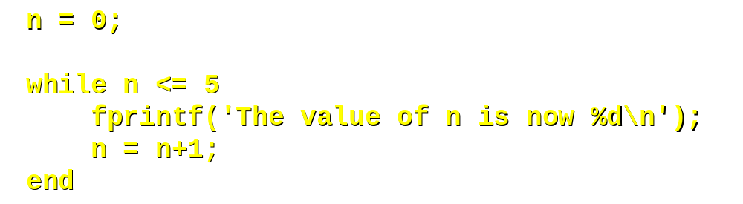
A “while-loop” example
One way of controlling the loop is to define a counting index; in this case we start with n = 0.
After the while statement an expression is defined that allows the loop to execute as long as the expression is true (1); in this case the loop runs until n > 5.
The counter must, of course, be changed in the loop, or the loop will run forever. In this case n is increased by 1 each time the block of commands in the loop is executed.

Slide 5
Your output should look like this:
The value of n is now 0
The value of n is now 1
The value of n is now 2
The value of n is now 3
The value of n is now 4
The value of n is now 5
>>

Slide 6
Another hands-on example
A program to sum a series of numbers input by a user:
a = 1;
a = 1;
n = 0;
n = 0;
myTotal
= 0.0;
myTotal
= 0.0;
while a >= 0
while a >= 0
a =
input('Enter
a number to add to the running ...
a =
input('Enter
a number to add to the running
total (
neg
# to end): '); if a>=0
total (
neg
# to end): ');
myTotal
=
myTotal
+ a;
myTotal
=
myTotal
+ a;
n = n + 1; end
n = n + 1;
end
end
% Note that the if >= 0 and end statements are needed in % this example.
fprintf('The
sum of the %d numbers you input is . . .
fprintf('The
sum of the %d numbers you input is
%12.3f
\
n',n,myTotal);
%12.3f
\
n',n,myTotal);

Slide 7
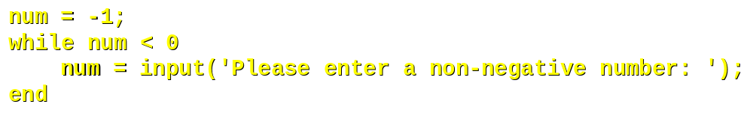
Another Example
In this example we want to ensure that the user inputs data in the correct range:
This loop will repeat until the user has entered a non-negative number (n >= 0)

Slide 8
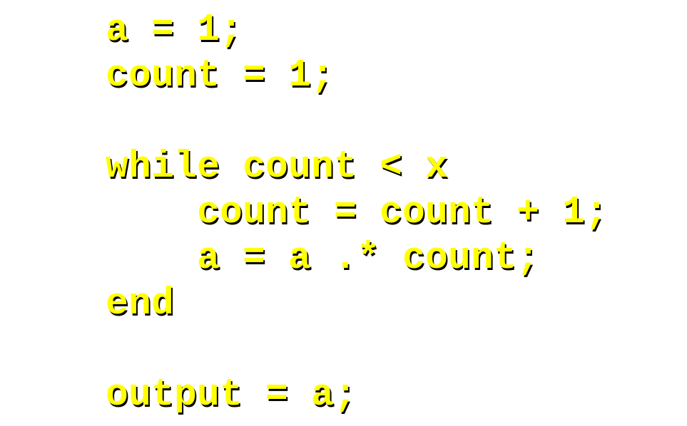

Hands on
Create a function called fact2 that calculates the factorial of a number using a while loop.

Slide 9
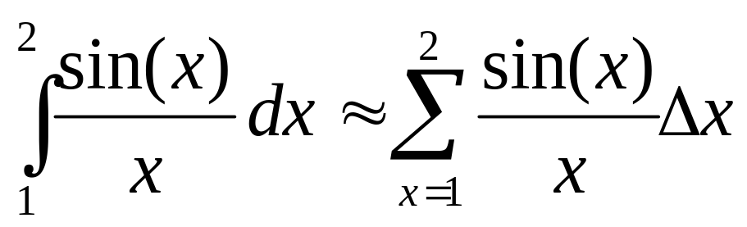
Exercise
Write a code that approximates the integral of sin(x)/x from 1 to 2. Use a while loop to sum the values of sin(x)/x from 1 to 2. Let the user input the increment to be used.
Hint: Use the following approximation:
The numerical value of this integral, to within four significant digits, is 0.6593.

Slide 10
Summary
Loops are MATLAB constructs that allow a sequence of MATLAB statements to be executed more than once.
While loops repeat a block of commands as long as an expression is true (1).
  while expression
  command #1
  command #2
  …
  end

